Slide 1
Stat 495r – Presenting Data
Week 7 – R Markdown

Slide 2
Announcements
Last day of in-person option for class, fully virtual remote after this
With virtual remote, please enable camera (if appropriate), speak up, ask questions, make comments, raise hands
Packsize Practicum is a possibility, but the data is messy
Would a data ninja volunteer some time to organize it in lieu of a homework or two?
Grades should be up to date, let me know if you have any questions
I’ll be better about posting them in a timely manner
Thanks to those that have utilized office hours – this is rewarding time

Slide 3
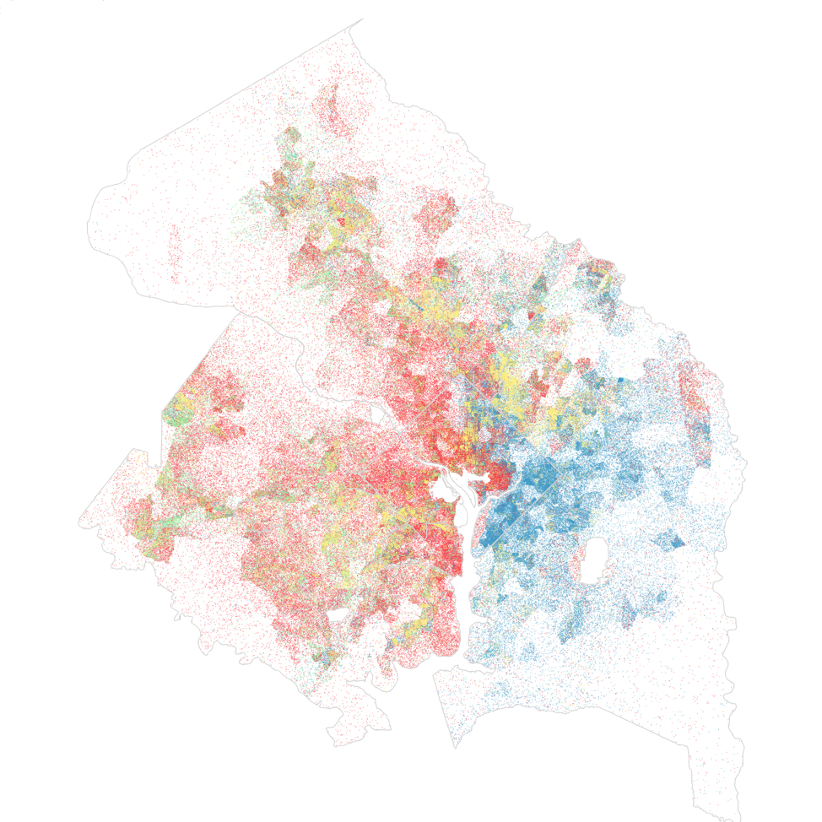
Data Viz #1
America is more diverse than ever – but still segregated

Slide 4
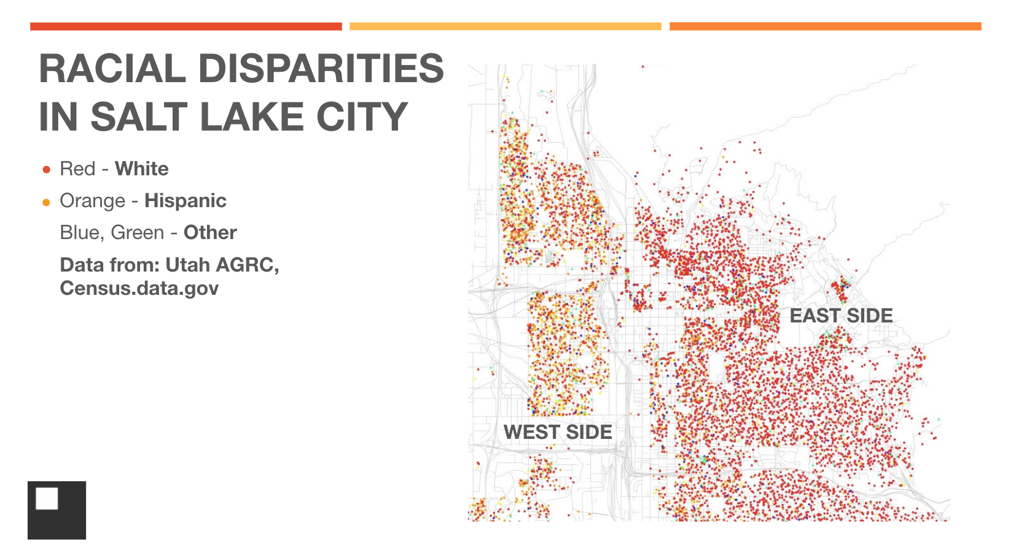
Data Viz #2

Slide 5
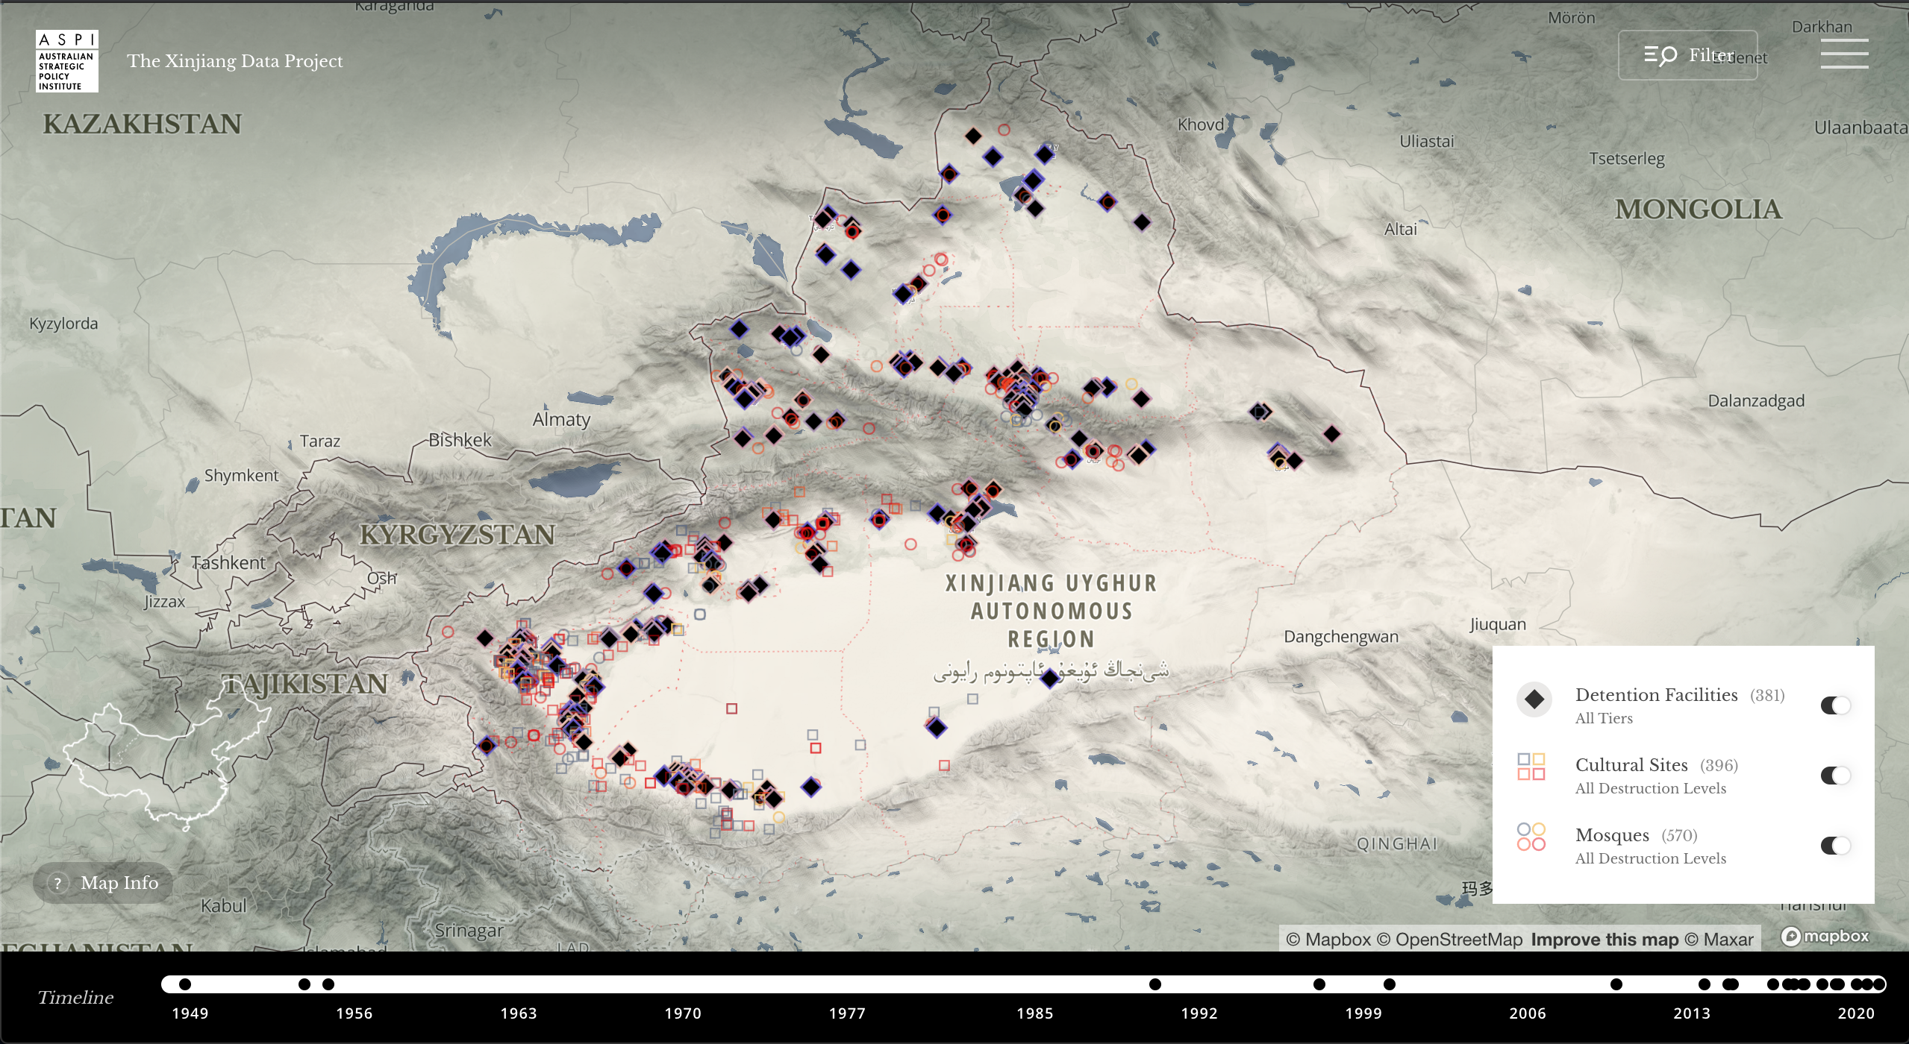
Data Viz #1

Slide 6

Quote of the Week
TBD

Slide 7
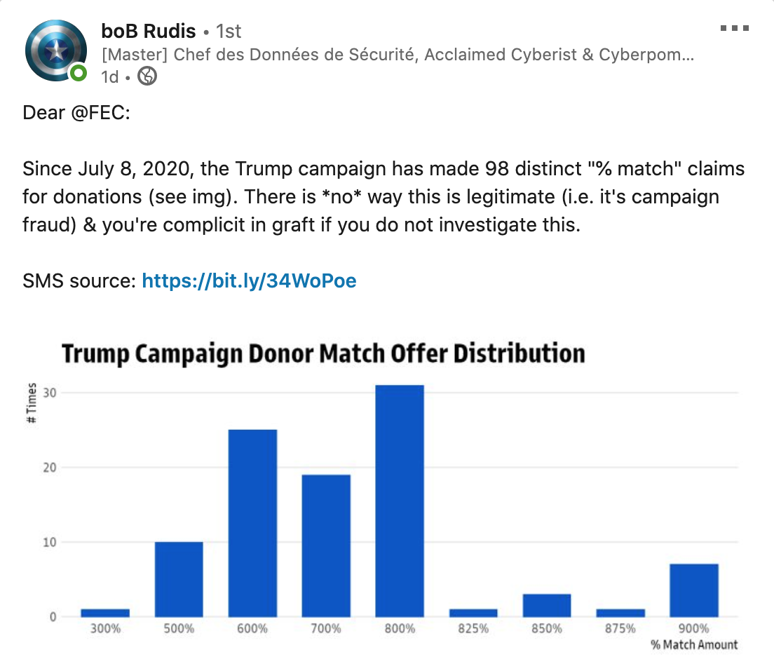

Slide 8
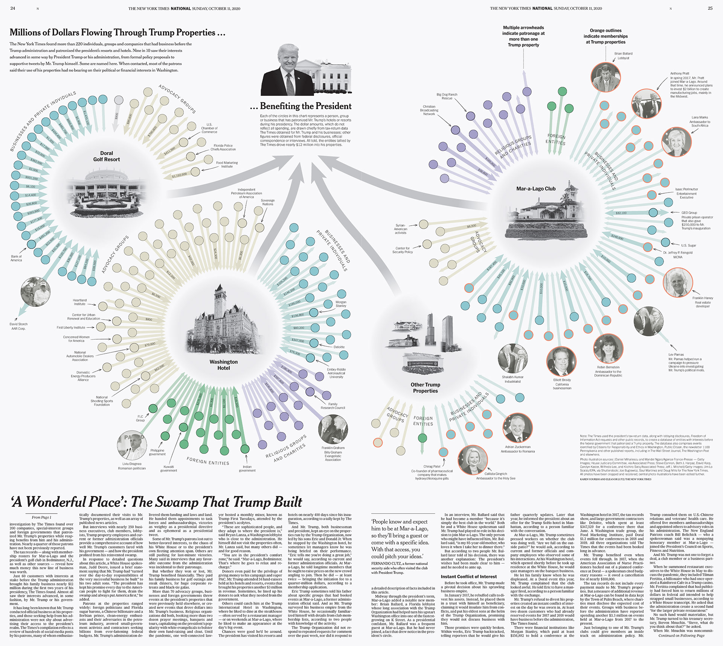

Slide 9
Homework 6

Slide 10
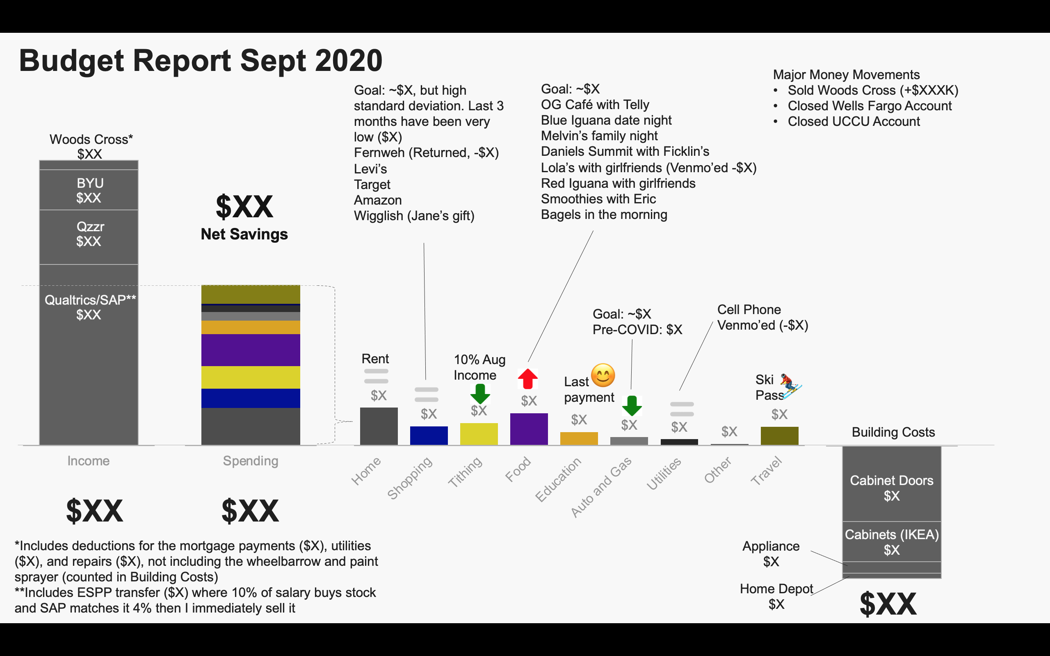



Budget Report Sept 2020
Major Money Movements
Sold Woods Cross (+$XXXK)
Closed Wells Fargo Account
Closed UCCU Account
Goal: ~$X, but high standard deviation. Last 3 months have been very low ($X)
Fernweh (Returned, -$X)
Levi’s
Target
Amazon
Wigglish (Jane’s gift)
Goal: ~$X
OG Café with Telly
Blue Iguana date night
Melvin’s family night
Daniels Summit with Ficklin’s
Lola’s with girlfriends (Venmo’ed -$X)
Red Iguana with girlfriends
Smoothies with Eric
Bagels in the morning
$XX
Net Savings
Goal: ~$X
Pre-COVID: $X
Cell Phone Venmo’ed (-$X)
Rent
10% Aug Income
😊
Ski Pass
Last payment
⛷️
Building Costs
Cabinet Doors
$X
$XX
$XX
*Includes deductions for the mortgage payments ($X), utilities ($X), and repairs ($X), not including the wheelbarrow and paint sprayer (counted in Building Costs)
**Includes ESPP transfer ($X) where 10% of salary buys stock and SAP matches it 4% then I immediately sell it
Appliance
$X
Cabinets (IKEA)
$X
Home Depot
$X
$XX

Slide 11

R Markdown

Slide 12
Why Document Style?
Code is fully reproducible
Can be outputted in PDF, Word, Slideshows, web pages and more

Slide 13




Who reads R Markdown?
Decision Makers
Focus on conclusions not code
Blog Readers
Be entertaining and brief
Other Data Scientists
Focus on code, document your work and how you arrived at your conclusions
Yourself
Homework, save your thinking

Slide 14
Markdown Language
Markdown is a coding language of it’s own for creating rich text from plain text. It focuses on readability. It is used in many different implementations:
Stack Overflow
GitHub
Blogging Platforms
Python Notebooks
Slack
R Markdown

Slide 15
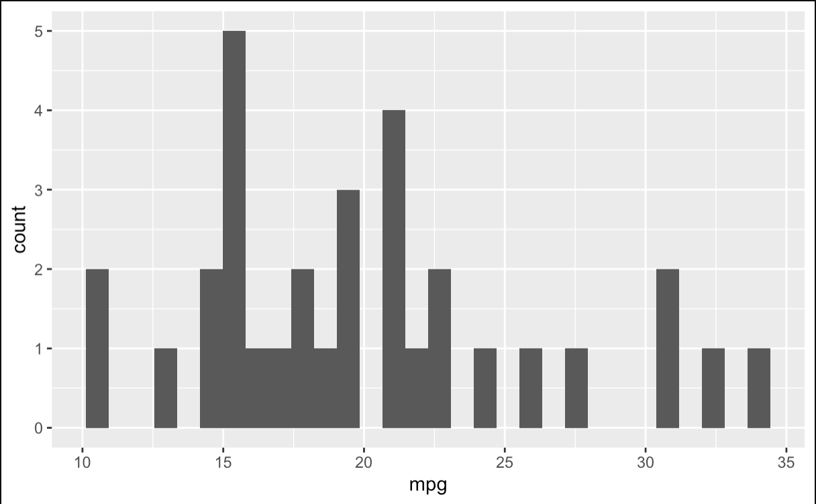
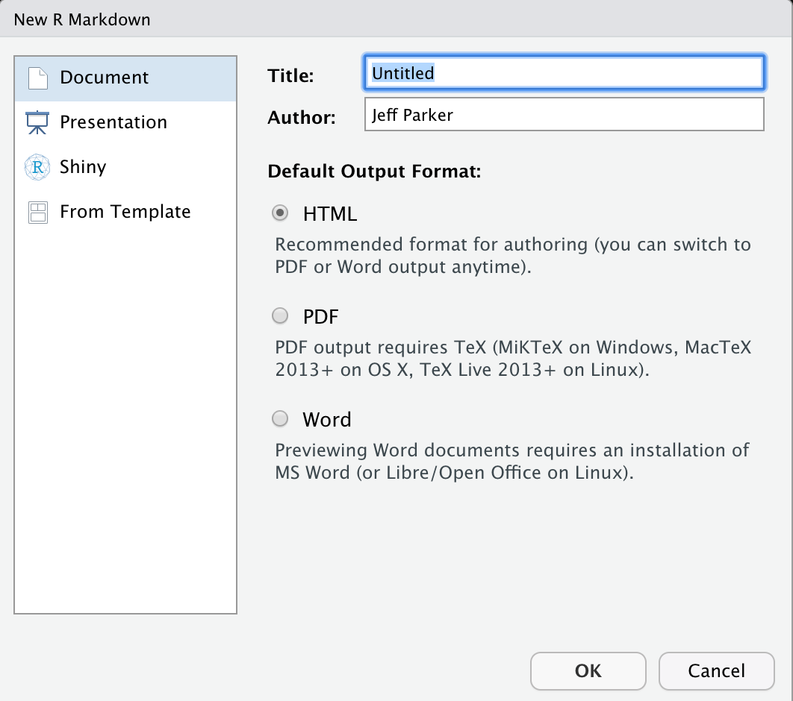
Getting Started with RMarkdown
RStudio includes the rmarkdown package pre-installed
Open a file that use the .Rmd extension
Write content using the R Markdown syntax
Run R code to include
Knit into a document
Embed R code in chunks
# Report
*Hello World*. My plot:
```{r}
ggplot(mtcars)+
geom_hist(
aes(mpg))
```
Report
Hello World. My plot:
# Report
*Hello World*. My plot:
```{r}
ggplot(mtcars)+
geom_hist(
aes(mpg))
```
File > New file > R Markdown or R Notebook
Notes:
Download MacTeX

Slide 16
Elements of an R Markdown
YAML Headers
---
title: "Untitled"
output: html_document
---
# Report
*Hello World*. My plot:
```{r}
ggplot(mtcars)+
geom_hist(
aes(mpg))
```
Text content
Code chunks
Cmd/Ctrl + Alt + i
Run or not run, check your environment and be careful with object names
Cmd/Ctrl + Shift + Enter
Notes:
Open a Rnotebook, run it, preview it, knit it
Open a R Markdown, run it, knit it
What’s different about the YAML headers?
Knit to each type

Slide 17
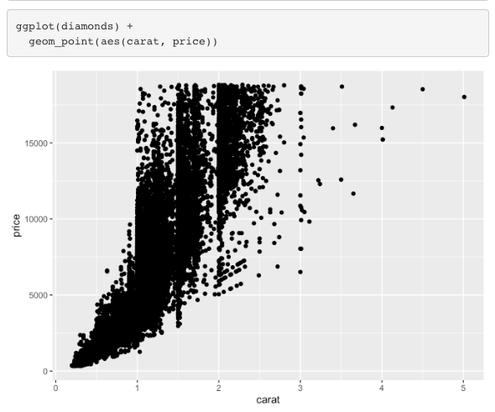
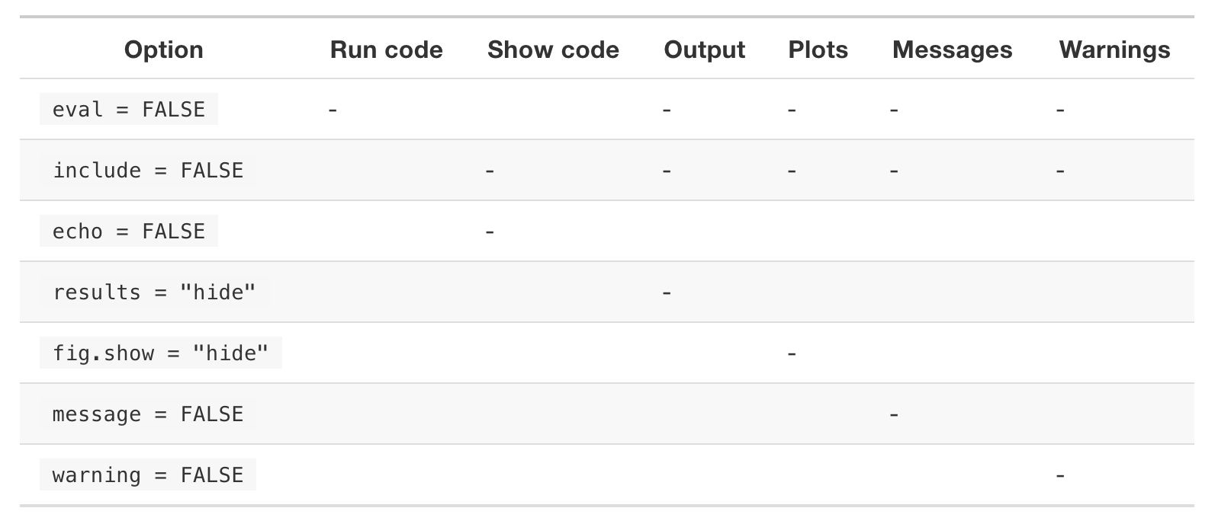
Code Chunk Options
```{r hist_plot}
ggplot(diamonds)+
geom_point(
aes(carat, price))
```
Code + Output
```{r echo = F}
ggplot(diamonds)+
geom_point(
aes(carat, price))
```
Output Only
No messages, warnings, errors
Code Only
```{r message = F, echo = F}
library(tidyverse)
```
```{r eval = F}
ggplot(diamonds)+
geom_point(
aes(carat, price))
```

Slide 18
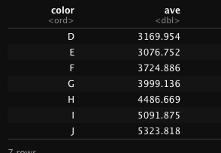
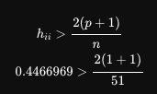
Code Inline
Code Chunks
There are `nrow(mtcars)` observations in our data & `ncol(mtcars)` variables
There are 32 observations in our data & and 11 variables
``` {r message = F}
diamonds %>%
group_by(color) %>%
summarise(ave =
mean(price)
```
$A = \pi*r^{2}$
A = π r²
$$
h_{ii} > \frac{2(p+1)}{n}\\0.44 > \frac{2(1+1)}{51}
$$
Notes:
In line code can only be ran when knitted
Why did I have to disable messages?
How can I make a better looking table?

Slide 19
Things to be aware of
Knitting can be finicky, previewing too – have patience
Make beautiful tables with knitr::kable
Caching can save you lots of time on re-knitting (e.g., loading in the data) by caching and using depencies ``` {r} cache = T) ```
Global options to consider
Echo = F if report
Formatting comma in large numbers
If in trouble, restart + run all chunks

Slide 20
YAML Header
Title
Author
Date (consider using a parameter !r lubridate::ymd("2015-01-01"))
Output
Parameters
Notes:
Show example of automating reports

Slide 21
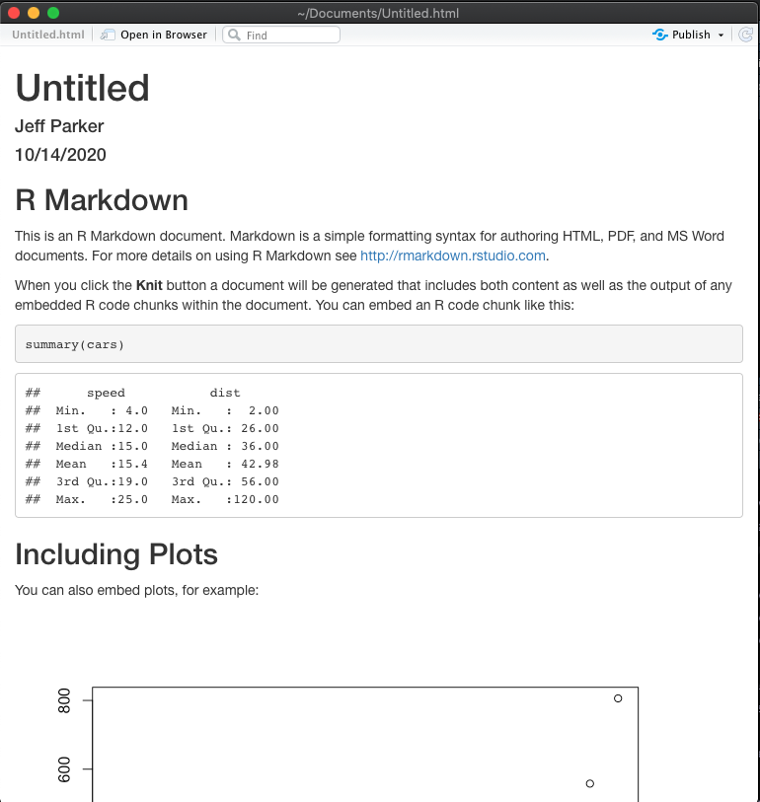
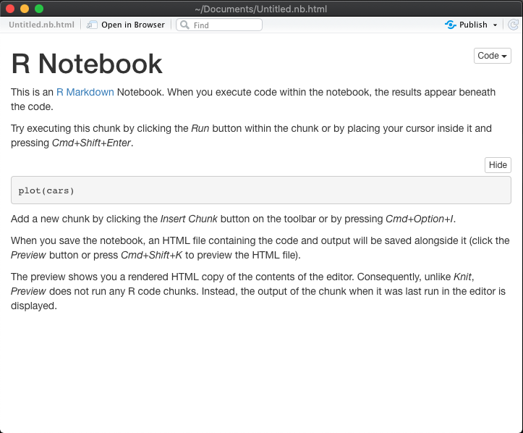
Knitting
Helpful toggles
Knitted R Markdown File
Runs the full file
Preview Mode in R Notebook
What was run is what you get
Once you Knit you can’t go back to Preview... sorta
Install MacTex for LaTeX if prompted

Slide 22
Publishing Documents
RServer
RPubs
GitHub
Notes:
You can save this as a HTML webpage in GitHub

Slide 23
R Shiny also works in R Markdown
Notes:
Flexdashboards

Slide 24
Dealing with Change

Slide 25
Beyond R Markdown and R Notebooks

Slide 26
Tips for Writing
LinkedIn and Blogs keep less than 7 minutes
Coding examples keep less than 15 minutes
Images, graphs, gifs etc go a long way
Make it look nice
It takes a long time to write a good article/post – plan accordingly

Slide 27
Activity

Slide 28
Activity
What stores are most likely to purchase drinks, refreshers, revivers and cookies?
Who is getting the most tips?

Slide 29
Homework

Slide 30
Homework 1
Klingons and Romulans were once enemies but have now formed a government and live in a somewhat peaceful democracy.
The society has three co-equal houses of government (president, senate, congress) each position is filled by either a Klingon (K) or a Romulan (R) as determined by popular vote. Elections take place towards the end of the year and the term starts at the beginning of the following year.
Presidential Bodies are elected every 4 years (e.g., 2298, 2302, 2306,...).
Senators and Congressional Representatives elections happen every 2 years (e.g., 2298, 2300, 2302,...). Although Senators and Congressional Representatives serve 6 and 2 year terms respectively, the open seats are staggered to maintain some continuity in the government.
Major laws require some cooperation between all 3 houses of government.
You are either a Klingon (K) or a Romulan (R). Use the data provided to write an op-ed styled article in rmarkdown (or Jupyter notebook), including your code, that convincingly demonstrate why your species is the best at governing the society.
No fake news – you must use the actual data provided and sound statistical techniques.
Consider which house is more relevant. Look at different time windows. Use different techniques (e.g., regression).
Send me an email with the URL with your article

Slide 31
HW1 Assignments
Student | Species Assignment
Zach | Klingon
Annie | Romulan
Parker | Klingon
Jenny Beth | Romulan
Kolby | Klingon
Kylee | Romulan
Kate | Klingon
Matt | Romulan

Slide 32
Reading Alternative
https://r4ds.had.co.nz/r-markdown.html
Listen to this fun podcast from NPR Marketplace: https://qz.com/496031/podcast-the-fine-art-of-making-data-into-sound/

